Slide 1

Communication Breakdowns Between Families and Alexa
2019
Erin Beneteau Julie A. Kientz Olivia K. Richards Jason Yip Mingrui Zhang Alexis Hiniker
Presentation By:
Syed Zain Ali

Slide 2
Structure of Paper
Discussion
Conclussion
Acknowledgments
Refrences
Abstract
Introduction
Related Work
Method
Results

Slide 3
ABSTRACT/Background
How families repair communication
10 diverse families to use an Amazon Echo Dot in theirhomes for four weeks
At least one childbetween four and 17 years old
59 communication breakdown interactions between family members and Alexa
Analysis with concepts from HCI and speech-language pathology
Repair communication breakdowns with Alexa
Alexa’s responses also influence the repair strategies
Designers can relieve the communication repair burden

Slide 4
INTRODUCTION
Human-to-technology communication are quickly becoming blurred in everyday
Increasing popularity of digital home assistants, increase users’ expectations
Humans must work to adapt their communication patterns to the needs of the machines, rather
than machines adapting to humans
People shorten their sentences, use simplified language, and repeat themselves to be understood
by voice interface
As a result, users of voice interface technology become frustrated and can fail to learn the full
capabilities of the technology, or abandon use altogether
Despite the difficulty, the technology is becoming pervasive

Slide 5
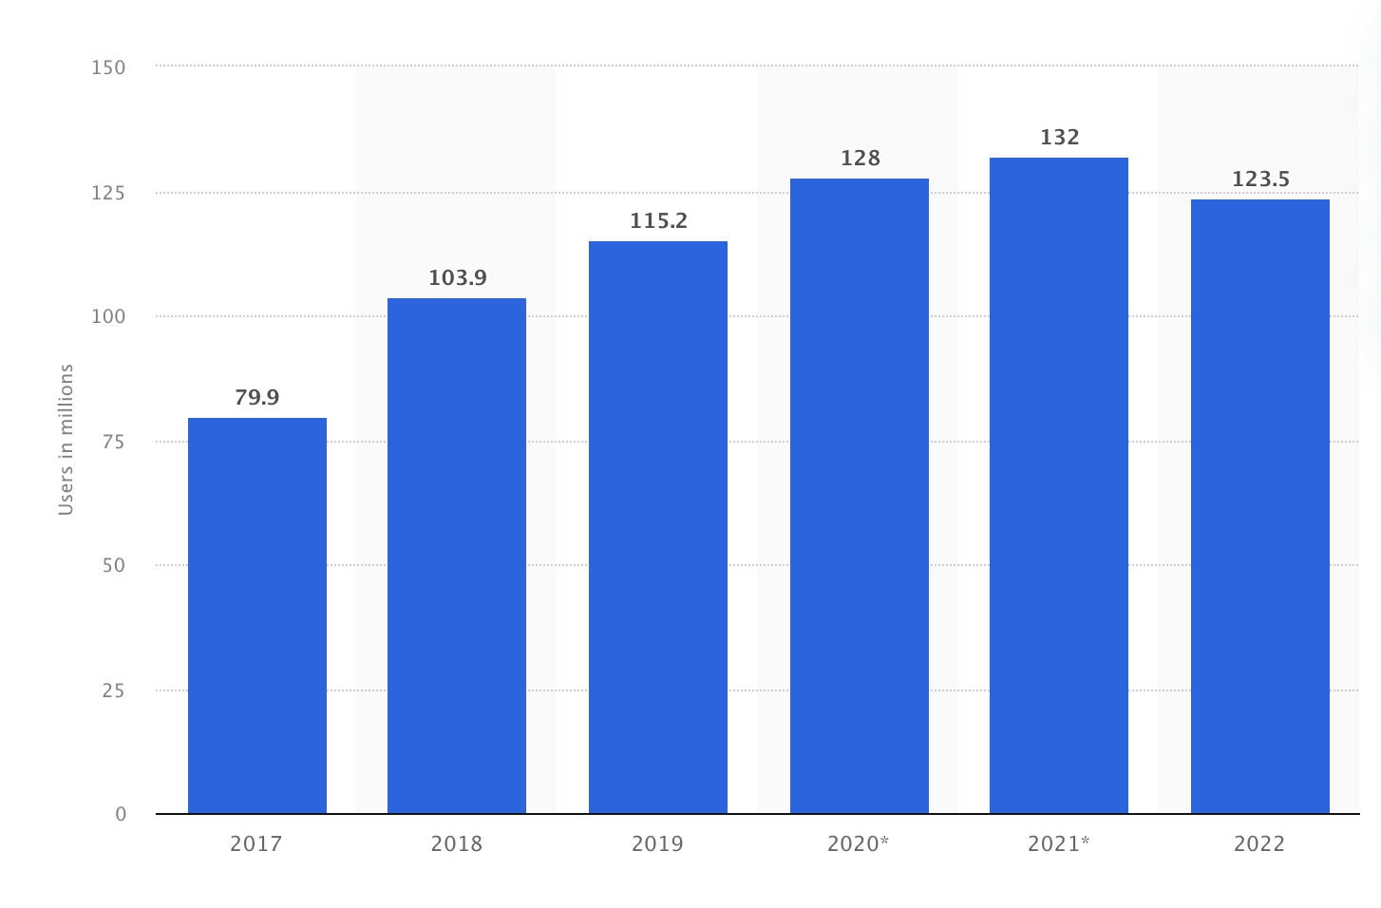
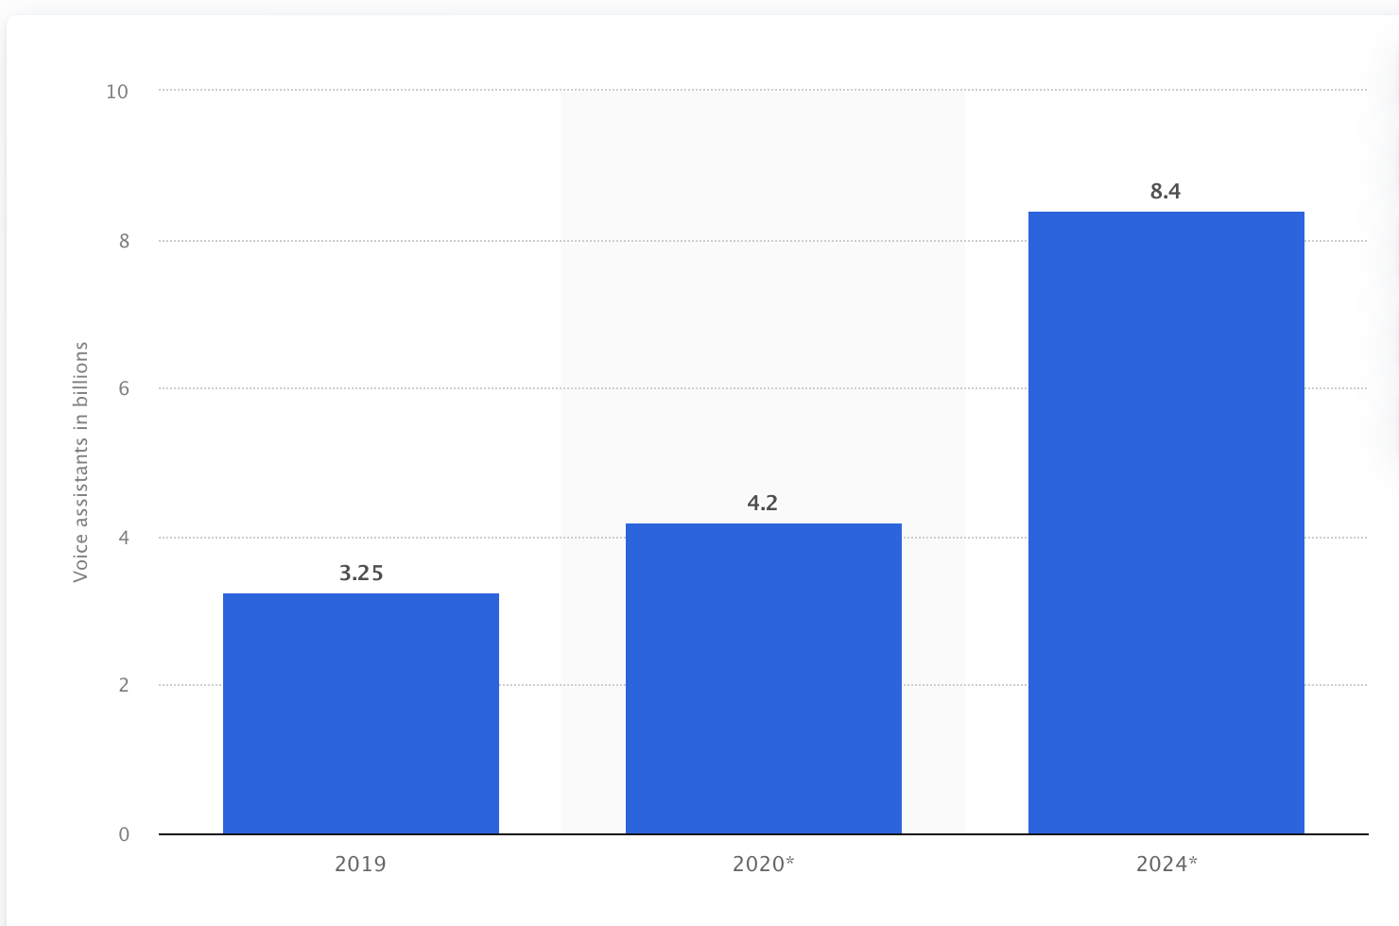
INTRODUCTION
Digital home assistants are anticipated to be present in 55% of American households by the year 2022
Number of voice assistant users in the United States
from 2017 to 2022
(in millions)
Number of digital voice assistants in use worldwide from
2019 to 2024 (in billions)*

Slide 6
INTRODUCTION
Research questions
What types of communication breakdowns occur?
How do families repair communication breakdowns with Alexa?
How does Alexa repair communication breakdowns with family members?
None of the families had previously owned a digital home assistant
59 conversational interactions
Three types of responses from Alexa
Five strategies that family members used to repair breakdowns
Designers could use the analysis of communication repair types to create relevant and helpful
responses for digital home assistants

Slide 7
Related Work
Human Communication and Communication Breakdowns
Speech-language pathology(SPL), pragmatics incorporates the social aspects of communication, including turn taking,
topic maintenance, socially appropriate speech and language use, and code switching.
Evaluation, treatment and prevention of communicaation errors
Code switching involves the recognition of different communicative expectations for different communication
partners/environment
E.G: A teenager uses a different conversational tone and different vocabulary when talking to friends than when talking to a
parent
Also used in daily life but no one focuses,linguistic code switching often begins around ages 4-5, when children
begin intentionally talking
in different ways to different people

Slide 8
Related Work
Communication repair refers to the work of restoring shared understanding after conversational
partners misunderstand each other
Initial rephrase
code switching is an aid
can take many forms and are dependent on the communicator’s language abilities
E.g childs use repetition
Children ages nine and older might use contextual cues, such as defining terms
Discourse scaffolding is a mechanism to guide learning through communication strategies with the
intention of gradually transferring skills and responsibility to the learner
An example of discourse scaffolding is when a child says, “cookie,” and a parent responds with an
expansion of the child’s utterance: “you want more cookies.
Human Computer Interaction

Slide 9
Communication Breakdowns with Voice Interfaces
Despite the “conversational” interface with conversational agents, people are not yet able to talk to
technology in the same way that they talk to other people
when a communication breakdown occurs with a conversational agent, multiple people attempt
communication repairs, passing the phone from person to person
Our specific interest is how families repair communication breakdowns
Joint Media Engagement JME
Parents, use media as shared learning opportunities
Children struggled to formulate queries

Slide 10
Method
10 diverse families
Two families were bilingual
Audio data throughout the four-week period
Record interactions every time the trigger word “Alexa“
Capture audio recordings of participants’ interactions with the Echo Dot, we created an audio
buffer system inspired by the open source code from Porcheron
It saves one minute of audio prior to the trigger word, along with three additional minutes
during and after the trigger word is spoken
Compensated families with US$100 in gift cards for completing the study
Approved by university’s Institutional Review Board

Slide 11
Method
Deployed the audio recording system on a Samsung tablet computer that families placed near the
Echo Dot in each of their homes.
Keep the tablet plugged in and no to use the tablet for anything , audio recording “record a thought”
button and a “delete”
None of the Families have already experienced with any home assistant

Slide 12
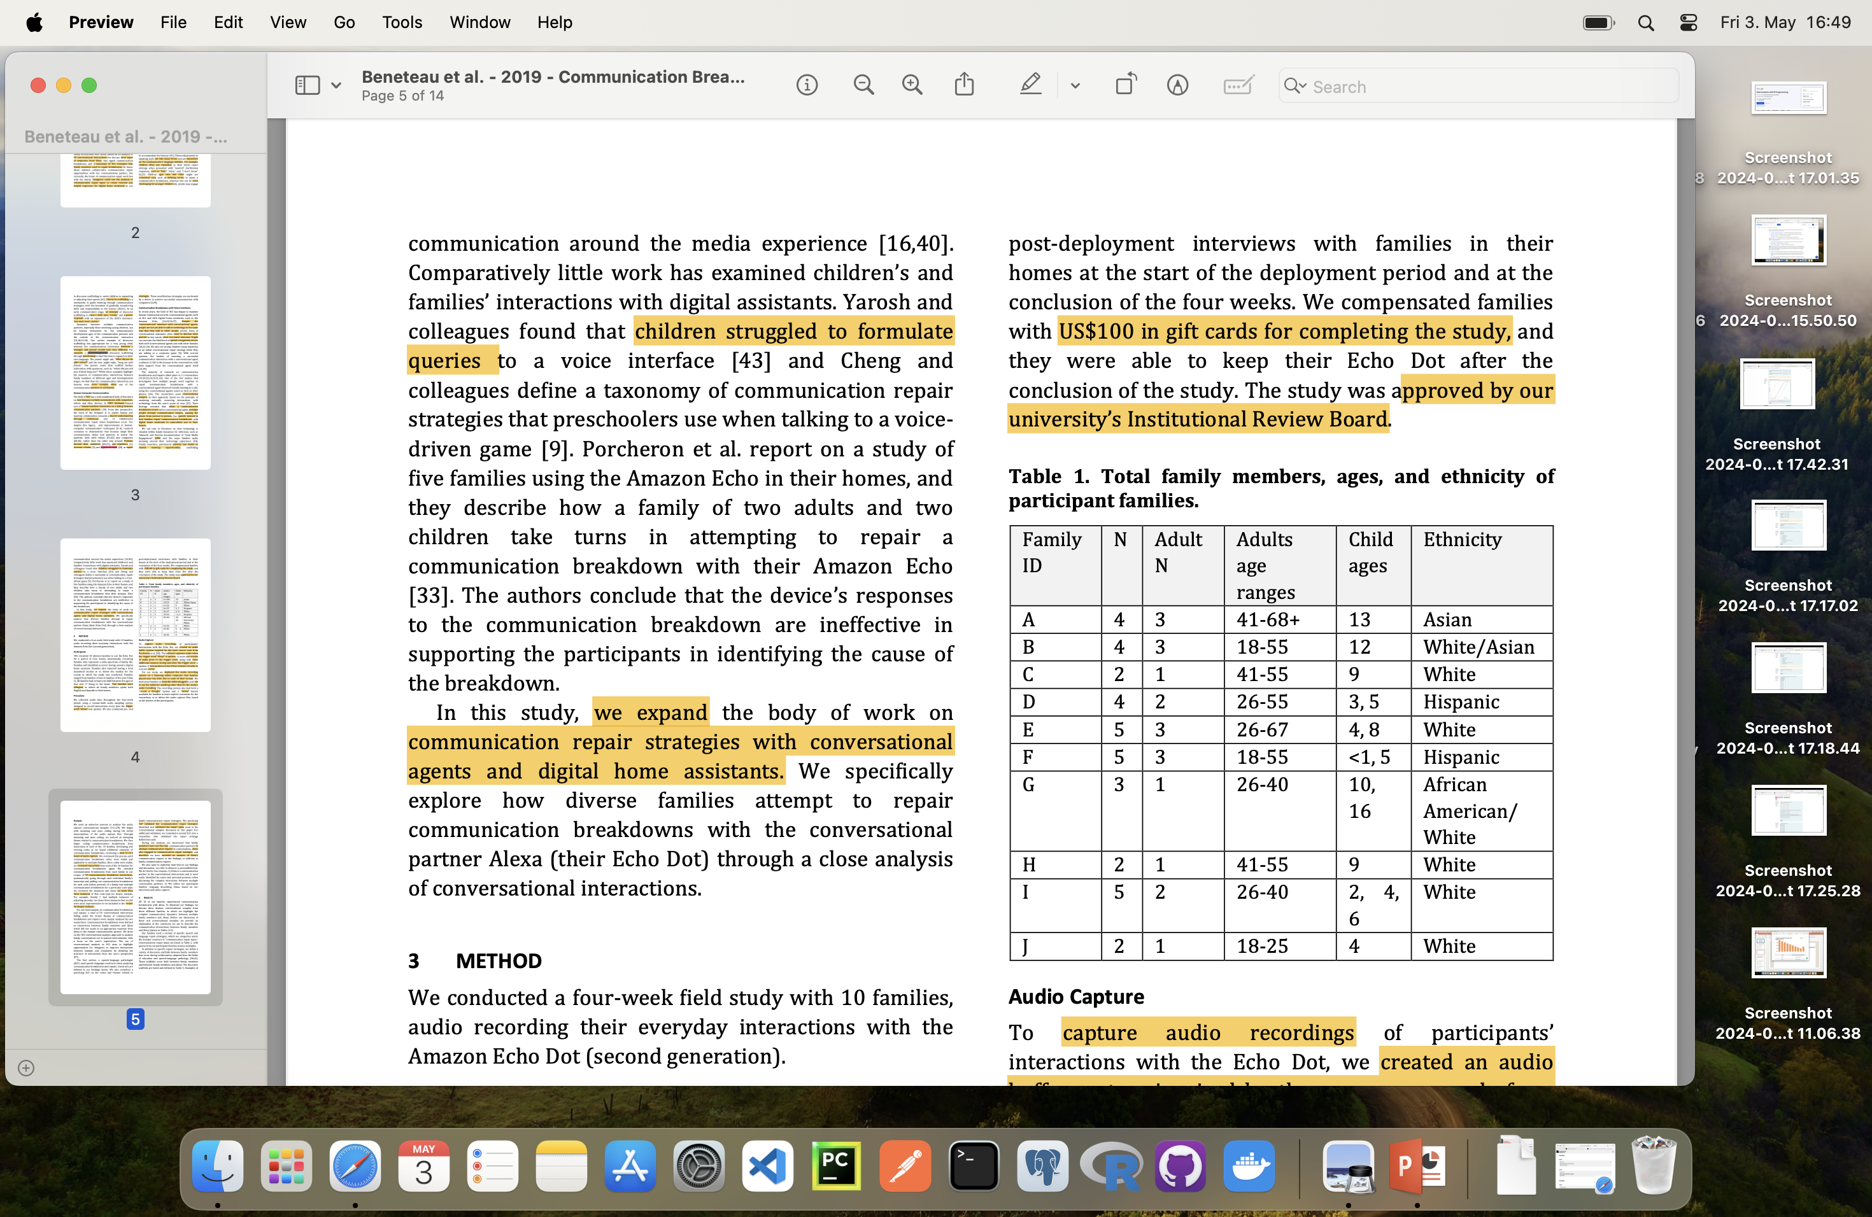

Slide 13
Analysis
Used an inductive process to analyze the audio
Reviewing a total of 14.5 hours of audio capture
Included communication breakdowns from each family in our corpus of 59 communication
breakdown interactions
Reviewed the instances and chose no more than three instances
SLP validated the communication repair strategies identified and validated the repair types
Used speech-language constructs when analyzing communication breakdowns and repairs

Slide 14
Analysis
Members were not the only communication partners to attempt communication repairs
Alexa also engaged in communication repair attempts
Therefore we have included an analysis of Alexa’s communication repairs in the findings

Slide 15
Results
All 10 of our families experienced communication breakdowns with Alexa
Explanation of the constructs
Discourse scaffolds between family members
Increased volume
Increased volume
Syntactical adjustments
Repitition
Semantic adjustments and modification
Consulting
Direct Instruction
Expansion

Slide 16
Results
Indication of communication breakdown
Therefore we have included an analysis of Alexa’s communication repairs in the findings
Acting on Misunderstanding
Neutral Clarification Response
Specific Clarification Response

Slide 17
Communication Breakdown 1: Family E
About popsicles
Conversation between Alexa and boy(8 years old)
Son: Alexa, (pause and music stops) what are popsicles made of?
Alexa: Three, six servings of s’mores popsicles are, you’ll need two cups cold milk, one . . .
(Alexa continues to talk)
Mother, talking over Alexa: She thinks it’s s’mores popsicles because you didn’t articulate.
Mother, in louder voice: Alexa, (pause and Alexa stops talking) how do you make a popsicle?
Alexa: Okay, for popsicles, I recommend a top recipe called sweet pink popsicle orange summers,
which take eight hours and five minutes to make

Slide 18
Communication Breakdown 1: Family E
What was wrong with first answer?
Alexa responds on the correct topic– popsicles –but provides too specific of a response that deviates
from the son’s intended.
Mother educate her son on improving his success in obtaining information from Alexa
By adjusting the syntax of the question from, “what are popsicles made of” to, “how do you make a
popsicle.”
Alexa assists her communication partners by refining her response
Ask for more information” or “say next and discourse scaffolding, turn talking

Slide 19
Communication Breakdown 2: Family B
Question!
“South Korea (pause) what part of Asia? Southeast or East Asia?“
What is wrong in the Question?

Slide 20
Mother: Alexa! South Korea is East Asian or Southeast Asian?
Alexa: Sorry, I’m not sure.
Daughter: Alexa. Are Koreans Southeast Asian? (Alexa beeps) (pause in family conversation)
Mother: Try again [daughter’s name].
Daughter, with increased volume: Alexa! Are Koreans Southeast Asian?
Alexa: I’m not quite sure how to help you with that.
Daughter: Hmmmm…
Mother: Alexa. Who is Eastern East Asia? What country is East Asia?
Alexa: There are no UN recognized countries in Eastern Europe.
Daughter: Augh…
Father, with raised voice: Alexa. Please define East Asian countries.
Alexa: This might answer your question. There are five UN recognized countries in Eastern Asia: China, Japan, South Korea,
North Korea, and Mongolia.
Did that answer your question?…..

Slide 21
Communication Breakdown 2: Family B
Syntax adjustments, semantics adjustments, changes in volume, changes in prosody
To clarify the last key term “Southeast Asian” vs “South.”
This form of question is essentially an either/or type of question, in which the requester provides
two options and is looking for a response that fits one of those options.
Alexa’s response, instead, is a neutral response, “Sorry, I’m not sure,” , “I’m not quite sure how to
help you with that.”
Father shifts the question to a specific, closed-ended request: “Please define East Asian countries.”

Slide 22
Communication Breakdown 3: Family D
Two key themes found across our participant families: children’s speech and language development impacting
communication
Alexa struggling to understand bilingual
5-year-old kid to ask a question
Child): uh (slight pause) leh (pause) ska. Is it going to rain for a little bit or is it going to be sunny for a little bit.c(said quickly and quietly), (pause) or both. (no rising intonation at end to indicate a question) (pause and no respons from Alexa)

Slide 23
Code Switching
Conversation without trigger word by child of age 5 in Family I
Older child (age 6) would say Alexa’s name and then pause
Alexa did not code switch with family members according to their ability
Child in Family J asked Alexa to tell jokes throughout the four-week deployment
Researcher‘s Question: Were they appropriate for the child?
Mother directs question to child) ‘do you know why the jokes were funny?
Did they make sense to you?’” The child’s response was “No, I don’t know why.”
What Could be the reason in your opinion?

Slide 24
Miss Communication
Family D says, “Alexa, play song by Marco Antonio Solis,” producing the singer’s name using
Spanish phonological processes instead of an English phonetic version of the singer’s name.
Alexa’s response is “‘Unbelieve,’ by Andy Groun
Because of inability to code switch
What is “Gar nicht“?
Alexa’s poor pragmatic skills is with Family A:
(Mother): Alexa, add 157 (slight pause)
(Alexa): I added 157 to your shopping list.
(Mother): Alexa, calculate 157 plus 50 (pause)
(Alexa): Sorry, I didn’t catch that.
“add” to “calculate” , Multiple meanings of words are a challenge for Alexa

Slide 25
Discussion
Recommendation that production with focus on improving communication repair strategies
Digital home assistants to artificially code switch as needed
Machines don‘t have pragmatic skills
May be possible to build on the concept of code switching, appropriate interactions
If designers imbued voice assistants with the skills to identify that a communication partner is a
young child or not
Will provide more efficeint feedback
Directive discourse scaffolding in Alexa “Can you tell me just the key word of what you want?”

Slide 26
Discussion
Joint media engagement is useful for designers to consider when creating applications and skills for
digital home assistants
Home assistants can simultaneously build their own pragmatic skills
Certain limitations in research eg 10 families only

Slide 27
Conclussion
Alexa makes some attempts to repair communication breakdowns
Using specific clarification responses, neutral clarification responses
We turn back to 1987 and Suchman’s guidance that designers focus on improving how
technology can promote shared understanding with their human communication
Improving technology’s ability will increase the use of this technology
By providing specific clarification responses

Slide 28
Communication Errors
https://www.youtube.com/watch?v=6MzmIUwFzds&t=9s
https://www.youtube.com/watch?v=6LELq9ZbS8o

Slide 29


Slide 30
References
[1] https://www.statista.com/statistics/973815/worldwide-digital-voice-assistant-in-use/
https://www.statista.com/statistics/1029573/us-voice-assistant-users/
[2] https://doi.org/10.1145/2484028.2484092
[3] https://doi.org/10.1145/3098279.3098539
[4] https://doi.org/10.1017/S030500090000088X
[5] Sharon L. James. 1990. Normal Language Acquisition. Allyn & Bacon, Incorporated
[6] https://doi.org/10.1145/2858036.2858288
[7] https://doi.org/10.1044/jshd.4702.123
[8] https://doi.org/10.1016/0010-0277(88)90003-0
[9] https://doi.org/10.1109/ROBOT.2008.4543743
[10] https://doi.org/10.1145/2858036.2858288
[11] https://doi.org/10.1145/2858036.2858478
[12] https://doi.org/10.1044/0161-1461(2002/009)
[13] https://doi.org/10.1097/01.TLD.0000269929.41751.6b
[14] https://doi.org/10.1044/jshd.4702.123
[15] https://doi.org/10.1044/leader.FTR1.17132012.14
[16] https://www.asha.org/public/speech/development/45/
[17] https://www.yaguara.co/voice-search-statistics/
[18] Geraldine P. Wallach and Katharine G. Butler. 1994. Language Learning Disabilities in School-Age Children and
Adolescents: Some Principles and Applications (1 edition ed.). Pearson, New York : Toronto : New York.

